Slide 1
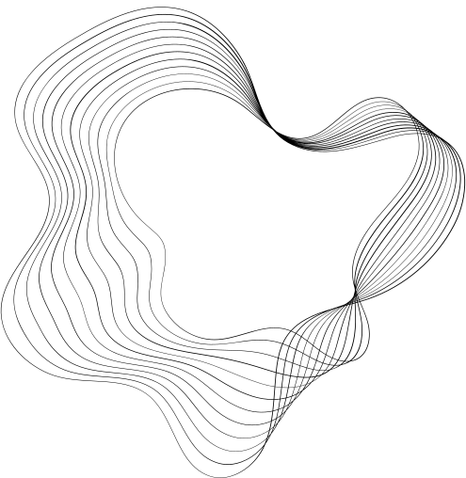

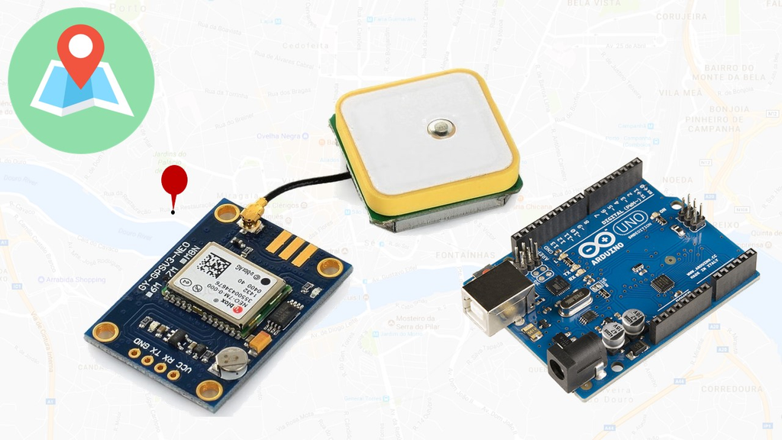
SMART GPS TRACKER WITH ARDUINO USING NEO-6M GPS MODULE

Slide 2
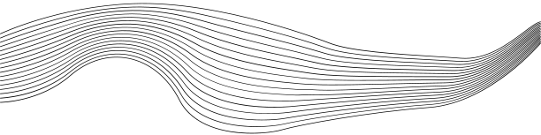
CONTENT
01
INTRODUCTION
02
COMPONENTS
03
ABOUT NEO-6M GPS MODULE
04
WORKING PRINCIPLE OF NEO-6M GPS MODULE
05
ADVANTAGES
06
APPLICATIONS
07
CONNECTION OF NEO-6M GPS MODULE WITH ARDUINO
08
PROGRAM FOR NEO-6M GPS MODULE
09
VIDEO OUTPUT FOR NEO-6M GPS MODULE

Slide 3



GLOBAL POSITIONING SYSTEM
The Global Positioning System (GPS) was developed by Roger L Easton in the year 1974.
GPS Is a network of satellites and receiving devices that help to find the location of something on Earth.

Slide 4
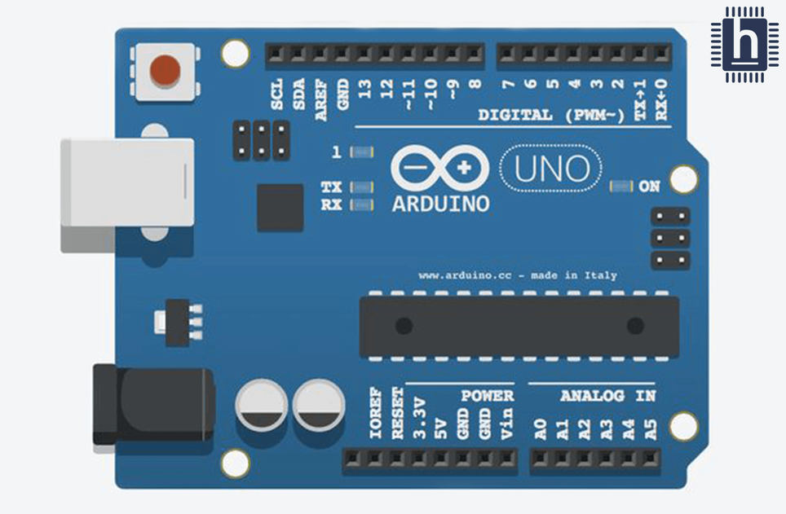
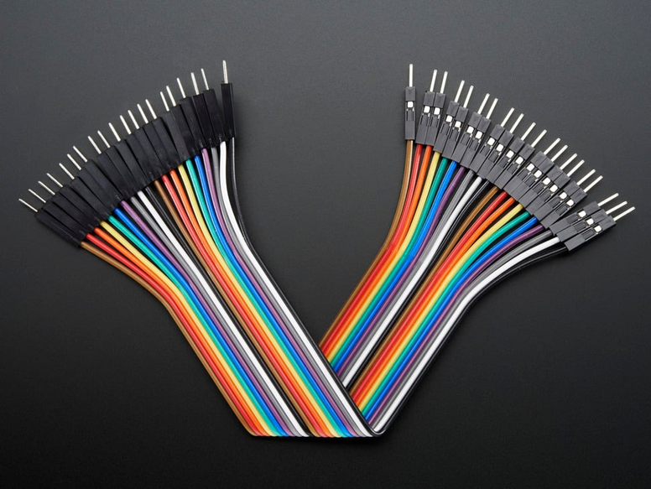
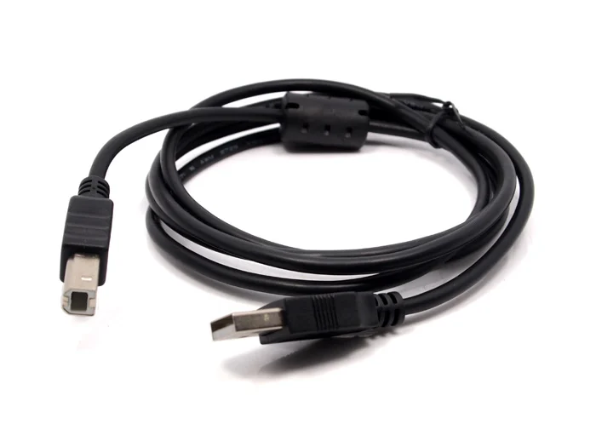
COMPONENTS
ARDUINO UNO
CONNECTOR WIRE
JUMPER WIRES

Slide 5
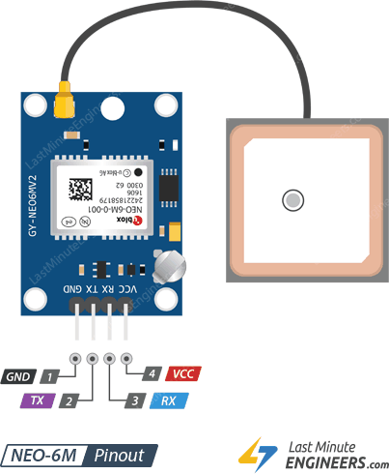
ABOUT NEO-6M GPS MODULE
The NEO-6M is a low-power Global Positioning System (GPS) module made by u-blox that can track up to 22 satellites and identify locations globally. It has a built-in antenna, GPS receiver, and non-volatile memory (EPROM) for storing configuration settings or other data.
It's commonly used in applications that require accurate positioning and navigation, such as geolocation and tracking.

Slide 6

WORKING PRINCIPLE OF NEO-6M GPS MODULE
GPS modules like the NEO-6M are small devices that help find your exact location using signals from satellites.
1.SATELLITE SIGNAL RECEPTION:
The NEO-6M module receives signals from multiple GPS satellites, as well as other satellite constellations like GLONASS and Galileo. These satellites transmit signals containing precise timing information and own orbital data.
2.SIGNAL PROCESSING :-
Inside the module, a special chip processes these signals, sort of like a mini-brain.
3.OUTPUTTING DATA:-
Once it knows where you are, the module shares this info in a simple language called NMEA sentences. It's like texting your location to your friends.

Slide 7
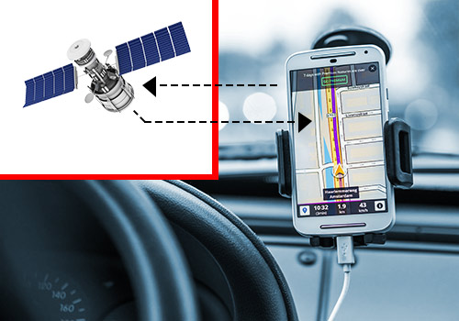
ADVANTAGES
1.ACCURACY:-
The module provides precise latitude and longitude data, typically within a few meters. It also has velocity accuracy of less than 0.1m/s and positional accuracy of just under 2m.
2.COMPATIBLE WITH UART DEVICES:-
Neo 6m GPS Module is fully compatible with UART devices such as the Raspberry Pi, Arduino, as well as the microprocessors.
3.STRONG SATELLITE SEARCH:-
The module has a 25 x 25 x 4 mm ceramic antenna that provides strong satellite search capabilities.

Slide 8
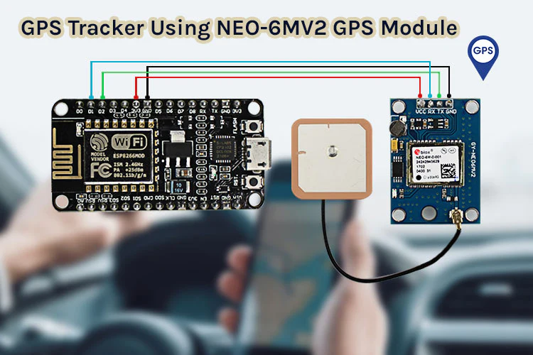
APPLICATIONS
1.VEHICLE TRACKING:-
The Neo 6m GPS module is used in real time situations like to track a vehicle's location, speed, and direction in real-time.
Ex:- Ambulance Tracking and Accident Detection.
2.PERSONAL NAVIGATION DEVICES:-
The module can be integrated into handheld navigation devices, such as GPS receivers, smartphones, and smartwatches, providing users with accurate location information.
3.GLOBAL POSITIONING AND NAVIGATION:-
By connecting the NEO-6M GPS module, you can access real-time positioning information, track movement, such as vehicle tracking, navigation systems, outside sports tracking, and more.

Slide 9
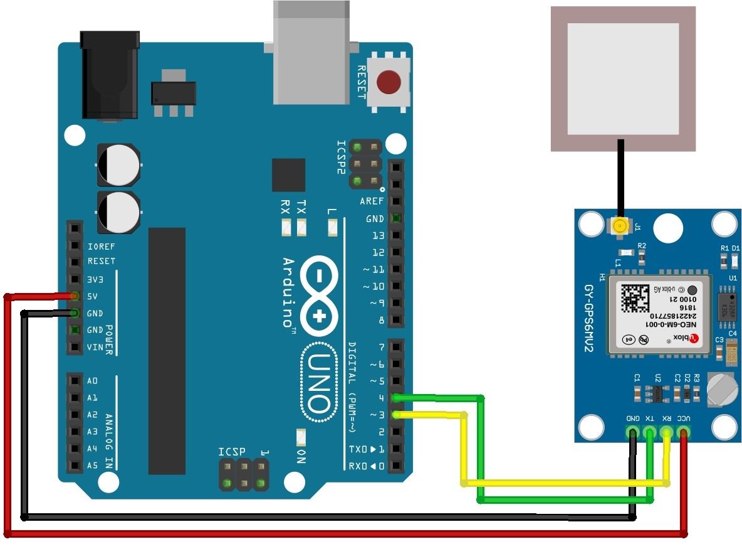
CONNECTION OF NEO-6M GPS MODULE WITH ARDUINO

Slide 10
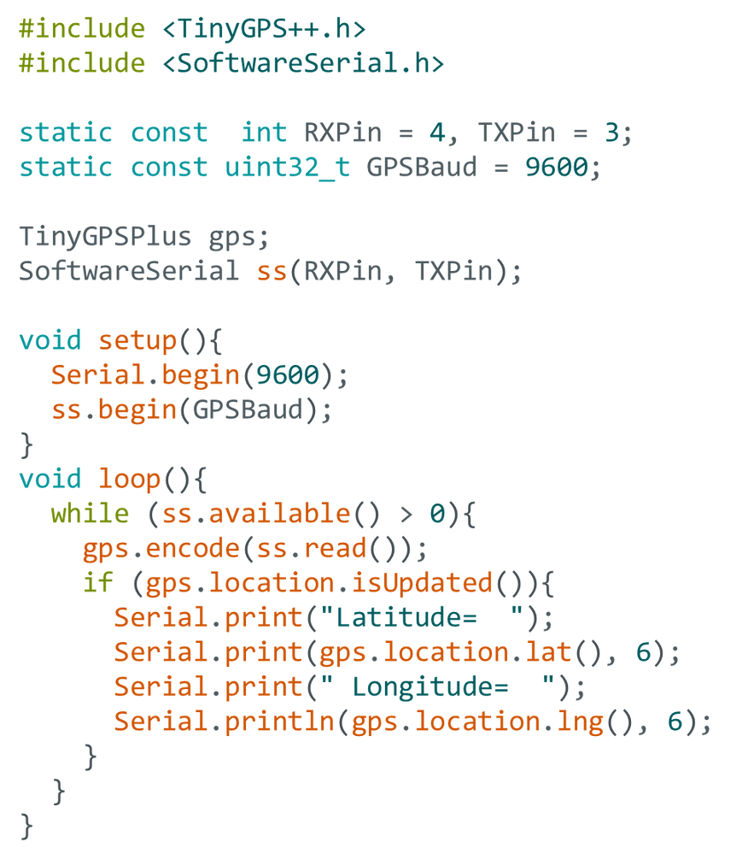
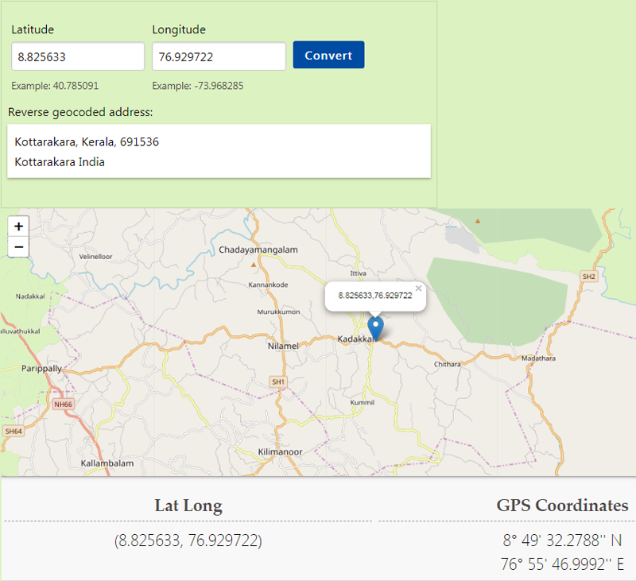
PROGRAM FOR NEO-6M GPS MODULE

Slide 11

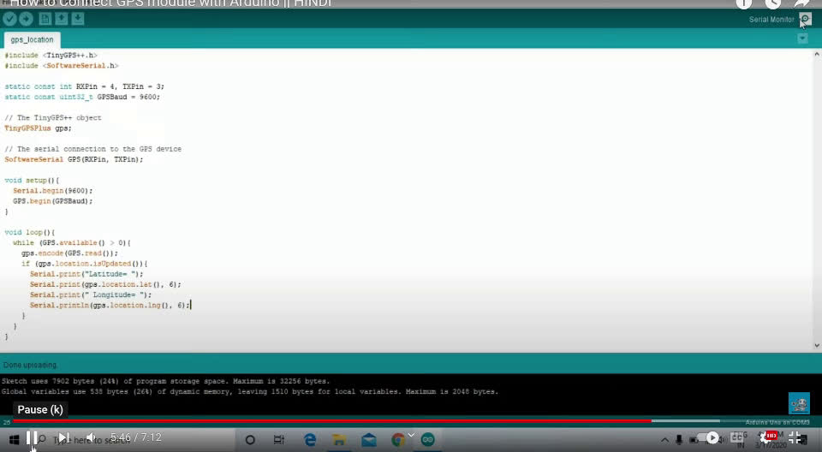
OUTPUT FOR NEO-6M GPS MODULE

Slide 12

THANK YOU
By
M. Subhakar
D. Sai Ganesh
B. Keerthi
V. Bhargavi

